Slide 1

The Smart Robot Brain
Explaining Weights, Bias, and Activation Functions

Slide 2
Meet Robo!
This is Robo, our smart robot friend.
He learns how to make decisions, just like you!

Slide 3

Robo's Brain: Neurons
Robo's brain is made of tiny parts called neurons.
Each neuron takes information in, does some math, and sends it out.

Slide 4
What Are Weights?
Weights are like volume knobs.
They control how important each piece of information is.
Big weight? Super important! Small weight? Not so much.

Slide 5
What is Bias?
Bias is like Robo’s mood adjuster.
Even if Robo hears nothing, the bias helps him still make a decision.
It adds a little extra push!

Slide 6
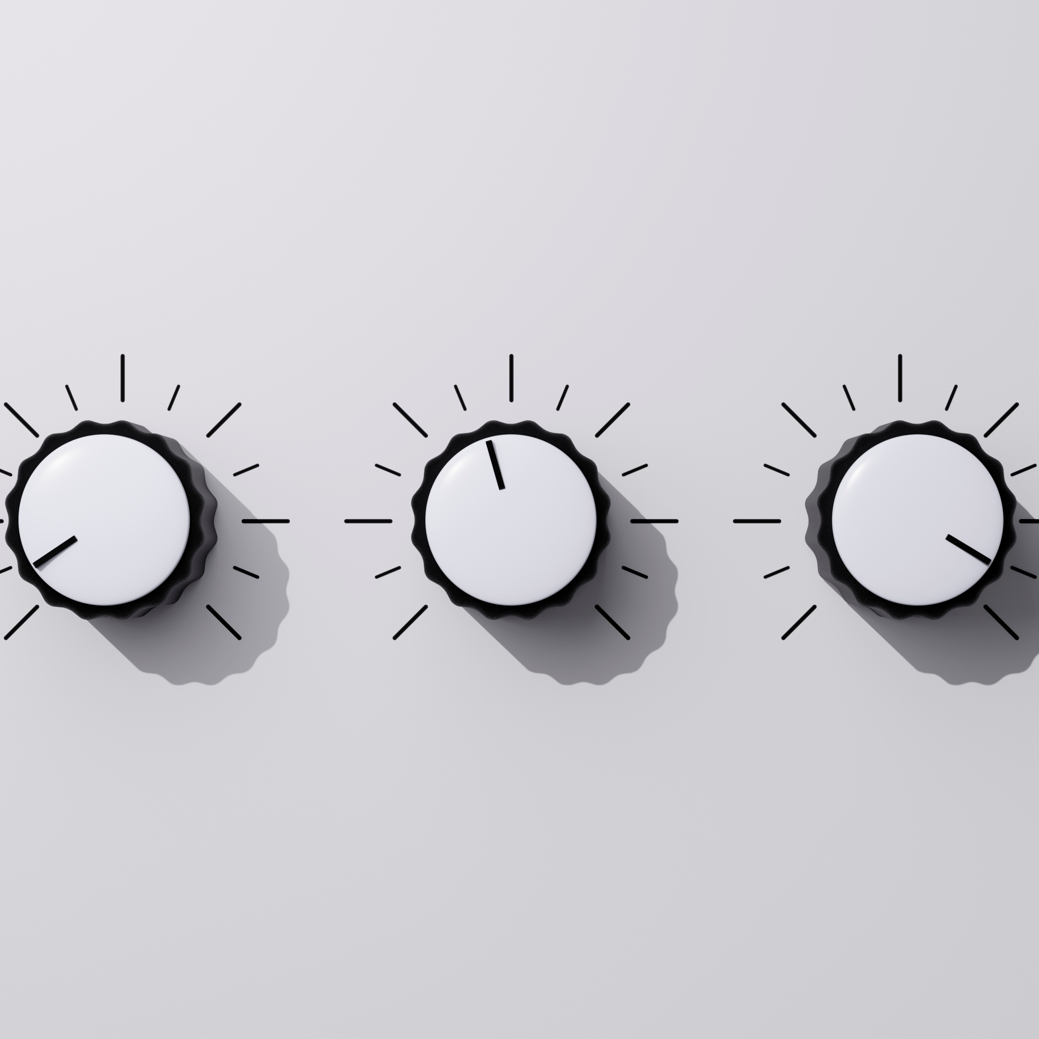
Activation Function = Robo’s Light Switch
This tells Robo if he should react or not.
Sometimes Robo ignores boring stuff (ReLU).
Sometimes he’s more sensitive (Sigmoid).

Slide 7
How Does Robo Learn?
Every time Robo makes a mistake, he updates his weights and bias.
That’s how he gets smarter, by practicing and adjusting!

Slide 8
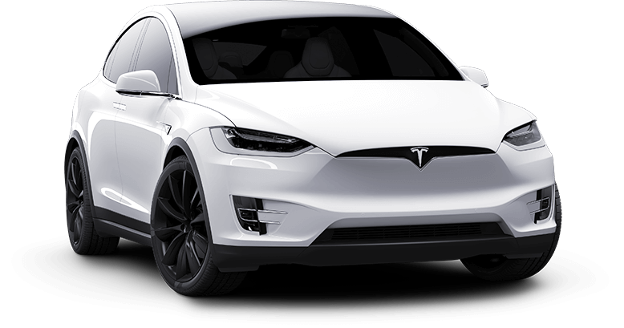
Where Do We See Robo?
Speech recognition, facial recognition, self-driving cars!
Robo's brain is in smart assistants, filters, even games.

Slide 9
Let’s Recap
Weights = Importance knobs
Bias = Mood adjuster
Activation Function = React switch
That’s how Robo makes smart decisions!

